Slide 1


TIME SERIES FORECASTING

Slide 2

Module Agenda
Introduction to Financial Forecasting
ARIMA Vs. SARIMA Vs. PROPHET
ARIMA (AutoRegressive Integrated Moving Average) Intuition
Live Demo 1: ARIMA for financial forecasting
SARIMA (Seasonal Autoregressive Integrated Average) Intuition
Hyperparameters Tuning and Optimization
Bias Variance Tradeoffs
Live Demo 2: Financial Forecasting using advanced dataset
Live Demo 3: Prices Forecasting Using Prophet (Python)
Facebook (Meta) Prophet
Practice Opportunity
© All rights reserved for Dr. Ryan Ahmed @Stemplicity Inc.

Slide 3
Financial Planning and Analysis
Data Wrangling & Analysis: Automate reconciliation and analysis of financial data.
Competitor Analysis: Analyze competitors' financials and strategic positioning.
Anomaly Detection: Identify errors in financial transactions with AI.
Time Series Forecasting: Predict financial performance using historical data and market trends.
Variance Analysis: Analyze actuals vs. budgets to pinpoint variances and corrective actions.
Scenario Planning: Model scenarios to evaluate business decisions' financial impacts.
Financial Narratives: Generate AI-driven insights for clear stakeholder communication.
Cost Optimization: Identify inefficiencies and recommend cost-saving measures.
Data Visualization: Visualize financial data for strategic decision making
Financial Prediction Using ML Regression: Predict financial metrics such as revenues& expenses.
Financial Planning and Analysis (FP&A) is a critical business function that focuses on providing financial insights to support decision-making and drive a company’s strategic objectives.
It involves analyzing financial data, forecasting future financial performance, budgeting, and offering recommendations to enhance financial health and operational efficiency.
© All rights reserved for Dr. Ryan Ahmed @Stemplicity Inc.

Slide 4
INTRODUCTION TO TIME SERIES FORECASTING

Slide 5

Financial Forecasting
Financial forecasting is the process of estimating or predicting a company's future financial performance based on historical data, current market conditions, and expected future events.
It helps organizations plan and strategize for growth, manage risks, and make informed decisions about budgeting, investments, and operations.
Why is Financial Forecasting Important?
Budgeting: Helps businesses allocate resources efficiently.
Decision-Making: Provides insights to guide investment and operational decisions.
Risk Management: Identifies potential financial risks & opportunities.
Growth Planning: Assists in setting realistic goals for expansion and profitability.
© All rights reserved for Dr. Ryan Ahmed @Stemplicity Inc.

Slide 6
Time Series Forecasting Techniques
Aspect | ARIMA | SARIMA | Prophet
Full Form | AutoRegressive Integrated Moving Average | Seasonal AutoRegressive Integrated Moving Average | Developed by Facebook; no acronym
Use Case | Forecasting non-seasonal time series data | Forecasting seasonal time series data | Forecasting with multiple seasonalities, holidays, and trends
Seasonality Handling | Cannot handle seasonality directly | Handles seasonality through seasonal parameters | Automatically detects and models seasonality
Key Parameters | p, d, q | p, d, q, plus seasonal parameters (P, D, Q, m) | Trend (growth), seasonality, holiday
Strengths | Effective for simple, non-seasonal data | Suitable for complex seasonal time series | Handles missing data, flexible, interpretable
Weaknesses | Poor performance on seasonal data | Can become complex with too many parameters | May not perform as well on data with no seasonality
Computational Efficiency | Fast for small datasets | Slightly slower due to additional parameters | Computationally efficient but resource-intensive for large datasets
Customizability | Limited | Moderate | High, with support for holidays and custom regressors
© All rights reserved for Dr. Ryan Ahmed @Stemplicity Inc.

Slide 7
AUTOREGRESSIVE INTEGRATED MOVING AVERAGE (ARIMA)

Slide 8
ARIMA (AutoRegressive Integrated Moving Average)
ARIMA is a forecasting technique used to predict future data based on past data, especially for things that change over time (like sales).
The model contains three parts:
AR (AutoRegressive): Relates the current value of the series to its past values using a linear relationship.
I (Integrated): Involves differencing the data to make it stationary, meaning its statistical properties (like mean and variance) do not change over time.
MA (Moving Average): Models the relationship between the current value and past forecast errors.
© All rights reserved for Dr. Ryan Ahmed @Stemplicity Inc.

Slide 9
ARIMA in Simple Terms
Imagine you’re running a store and trying to predict today’s sales based on patterns from the past.
1. AR (AutoRegressive): Sales depend on past sales
Think of AR like a sales trend that repeats. If sales were high yesterday, they might still be high today because customers tend to shop around the same time each week.
Analogy: "If I sold 100 items yesterday, I’ll probably sell the same number today, adjusted slightly up or down"
2. I (Integrated): Removing long-term trends or seasonal changes
This focuses only on what’s changing day-to-day. For example, if sales increase every week because of a growing customer base, you want to subtract that steady growth trend to predict the variations more accurately.
Analogy: "If sales have been increasing 10x every week, I’ll subtract that growth to focus on daily fluctuations.“
3. MA (Moving Average): Fixing unexpected errors
This part adjusts for surprises that happened recently. For example, if you unexpectedly ran out of stock two days ago and sales dropped, this might affect predictions today.
Analogy: "If I sold fewer items yesterday because I had a stock issue, I’ll adjust my forecast upwards today, assuming I’ve restocked."
© All rights reserved for Dr. Ryan Ahmed @Stemplicity Inc.

Slide 10
Financial Planning and Analysis
Pulling it All Together in ARIMA, let’s predict today’s sales:
AR (AutoRegressive): Start with how many items you sold on similar past days.
I (Integrated): Adjust for trends, like seasonal growth or steady increases.
MA (Moving Average): Account for unusual recent events, like a sudden sale or a stock problem.
In simple terms, ARIMA combines patterns (AR), trends (I), and corrections for surprises (MA) to make your sales predictions as accurate as possible!
© All rights reserved for Dr. Ryan Ahmed @Stemplicity Inc.

Slide 11
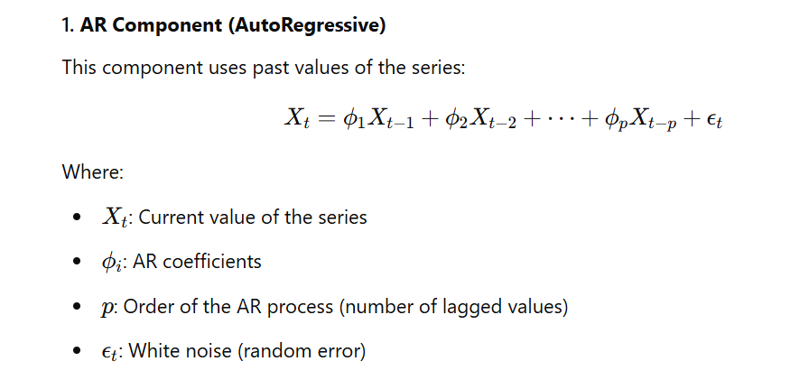
ARIMA Math!
© All rights reserved for Dr. Ryan Ahmed @Stemplicity Inc.

Slide 12
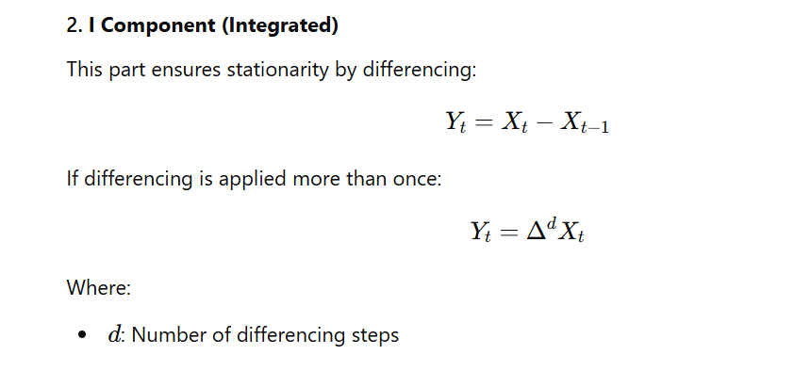
ARIMA Math!
© All rights reserved for Dr. Ryan Ahmed @Stemplicity Inc.

Slide 13
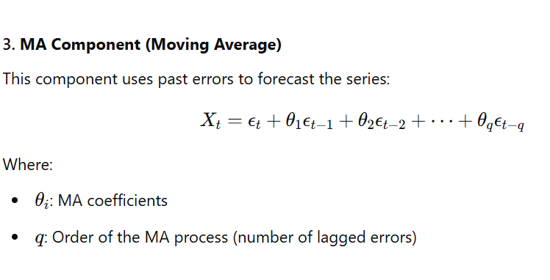
ARIMA Math!
© All rights reserved for Dr. Ryan Ahmed @Stemplicity Inc.

Slide 14
ARIMA Parameters
The ARIMA model is defined as ARIMA(p,d,q), where p, d, and q represent the model parameters:
p: number of lag observations in the model, also known as the lag order.
d: number of times the raw observations are differenced to make the series stationary.
q: size of the moving average window, also known as the order of the moving average.
In Simple terms:
p = How much past data to use (AR part)
d = How many times to adjust the data to remove long-term trends (I part)
q = How much past error to consider (MA part)
© All rights reserved for Dr. Ryan Ahmed @Stemplicity Inc.

Slide 15

SARIMA
SARIMA, or Seasonal Autoregressive Integrated Moving Average, is an extension of the ARIMA model designed to handle time series data exhibiting both trend and seasonality.
While ARIMA models account for non-seasonal patterns through autoregression (AR), differencing (I), and moving averages (MA), SARIMA incorporates additional parameters to capture recurring seasonal effects.
© All rights reserved for Dr. Ryan Ahmed @Stemplicity Inc.

Slide 16
LIVE DEMO 1: GENAI FOR SALES FORECASTING USING ARIMA + HYPERPARAMETERS TUNING

Slide 17
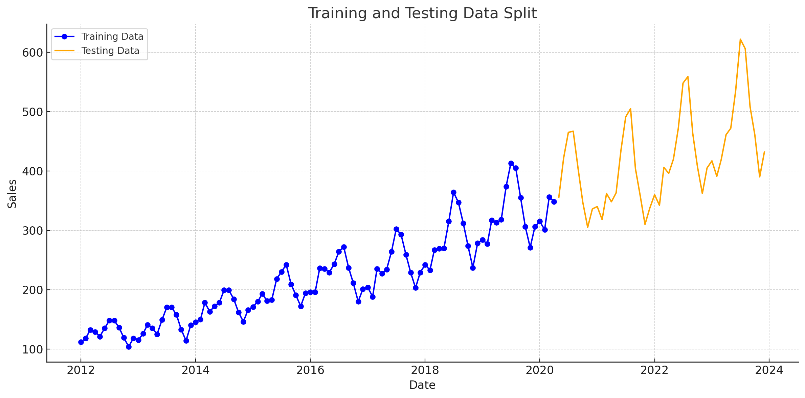
Problem Statement
This project uses the ARIMA model to forecast unit sales for pet supplies at a department store. The primary objectives are as follows:
Model Development: Implement the ARIMA model to predict future sales trends.
Hyperparameter Optimization: Perform hyperparameter tuning to identify the optimal values for the parameters p, d, and q.
Evaluation and Visualization: Compare the forecasted sales data with actual sales (ground truth) through comprehensive plots to evaluate model performance.
© All rights reserved for Dr. Ryan Ahmed @Stemplicity Inc.

Slide 18
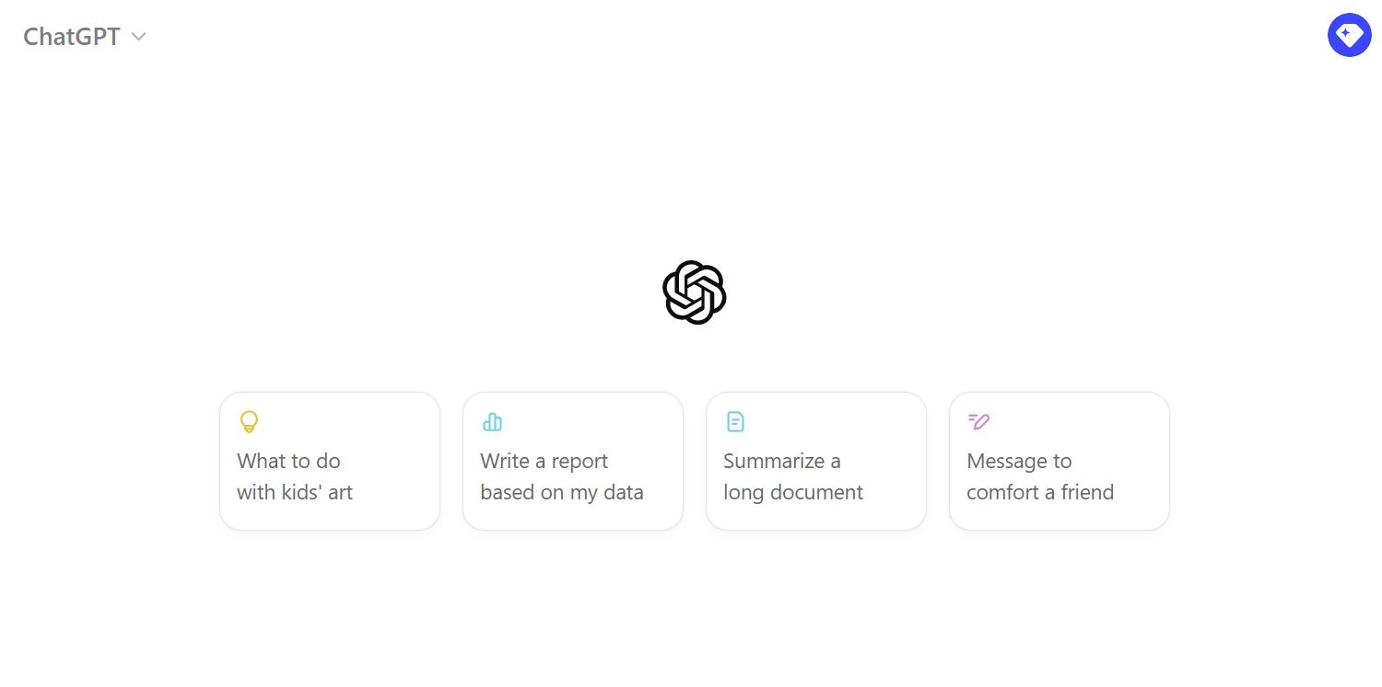
Live Demo:
🔗 Click here to explore ChatGPT ChatGPT Signup
💡 Click here for AI Prompts Explore Prompts
© All rights reserved for Dr. Ryan Ahmed @Stemplicity Inc.

Slide 19
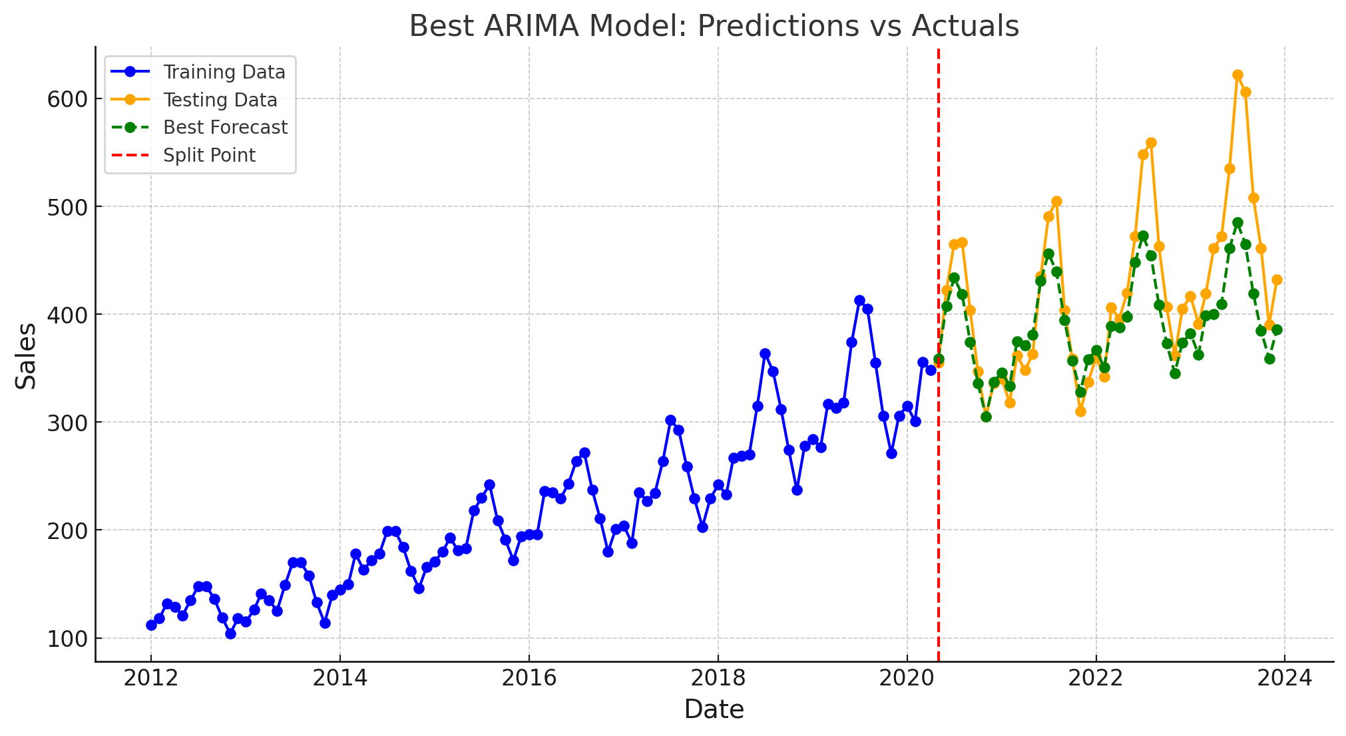
Expected Output
The ARIMA model was optimized using the specified parameters:
Best Order (p, d, q): (11, 1, 11)
Mean Absolute Error (MAE): 35.78, demonstrating strong performance with a relatively low error.
© All rights reserved for Dr. Ryan Ahmed @Stemplicity Inc.

Slide 20
PRACTICE OPPORTUNITY

Slide 21

Practice Opportunity
Objective
Using the same dataset as before, analyze the time series dataset to build predictive models, tune hyperparameters, and compare ARIMA and SARIMA models.
Steps Overview
Load and preprocess the dataset (convert dates, sort, and split into 80% training and 20% testing).
Train ARIMA on training data, predict on testing data, and evaluate (MAE) using different values for the hyperparameters. Try to improve model performance compared to the lecture demo.
Train SARIMA with seasonal parameters.
Compare ARIMA and SARIMA performance metrics.
Discuss SARIMA's advantages for seasonal datasets.
© All rights reserved for Dr. Ryan Ahmed @Stemplicity Inc.

Slide 22
Practice Opportunity Solutions
🔗 Click here to explore ChatGPT ChatGPT Signup
💡 Click here for AI Prompts Explore Prompts
💡 Click here for Practice Opportunities Solution Explore Prompts
© All rights reserved for Dr. Ryan Ahmed @Stemplicity Inc.

Slide 23
BIAS-VARIANCE TRADE-OFF

Slide 24
Bias Variance Intuition
Assume we want to model the relationship between the temperature and weekly sales.
As temperature increases, people tend to be happier and shop more. This will likely increase the weekly sales.
As the temperature exceeds a specific limit, sales tend to plateau and no longer increase.
PERFECT (TRUE) MODEL!
© All rights reserved for Dr. Ryan Ahmed @Stemplicity Inc.
Weekly Sales
Temperature

Slide 25
Bias Variance Intuition: Training Vs. Testing Split
Dataset is divided into training and testing datasets.
Testing datasets have never been seen by the model before.
Training
80%
Weekly Sales
Available Dataset
© All rights reserved for Dr. Ryan Ahmed @Stemplicity Inc.
Testing Dataset
Testing
20%
Training Dataset
Temperature

Slide 26
Bias Variance Intuition: Simple Model
Linear Regression model uses a straight line to fit the training dataset
Linear regression model lacks flexibility, so it cannot properly fit the data (as the true perfect model does!)
The linear model has a large “bias” which indicates that the model is unable to capture the true relationship between temperature and weekly sales accurately.
PERFECT (TRUE) MODEL!
© All rights reserved for Dr. Ryan Ahmed @Stemplicity Inc.
Weekly Sales
LINEAR REGRESSION MODEL
Training Dataset
Temperature

Slide 27
Bias Variance Intuition: Complex Model
High order polynomial model can have a very small bias and can perfectly fit the training dataset.
High-order polynomial model is very flexible
PERFECT (TRUE) MODEL!
Weekly Sales
© All rights reserved for Dr. Ryan Ahmed @Stemplicity Inc.
HIGH ORDER POLYNOMIAL (COMPLEX) MODEL
Training Dataset
Temperature

Slide 28


Bias Variance: Simple vs. Complex Models During Training
Training Dataset
PERFECT (TRUE) MODEL!
Training Dataset
PERFECT (TRUE) MODEL!
Weekly Sales
Weekly Sales
HIGH ORDER POLYNOMIAL (COMPLEX) MODEL
LINEAR REGRESSION MODEL
© All rights reserved for Dr. Ryan Ahmed @Stemplicity Inc.
Temperature
Temperature
SUM OF SQUARES (LARGE)
SUM OF SQUARES (SMALL ~0)
THIS IS NOT THE FULL STORY!!

Slide 29
Bias Variance: Simple vs. Complex Models During Testing
PERFECT (TRUE) MODEL!
Testing Dataset
PERFECT (TRUE) MODEL!
Testing Dataset
Weekly Sales
Weekly Sales
HIGH ORDER POLYNOMIAL (COMPLEX) MODEL
LINEAR REGRESSION MODEL
© All rights reserved for Dr. Ryan Ahmed @Stemplicity Inc.
Temperature
Temperature
SUM OF SQUARES (ACCEPTABLE!)
SUM OF SQUARES (LARGE)

Slide 30
Bias Variance Tradeoff
Optimum Model
Variance
Total Error
Error
© All rights reserved for Dr. Ryan Ahmed @Stemplicity Inc.
Bias
Model Complexity
Linear
Polynomial

Slide 31
Bias Variance Tradeoff
MODEL #1 (LINEAR REGRESSION) (SIMPLE) | MODEL #2 (HIGH ORDER POLYNOMIAL) (COMPLEX)
Model has High bias because it is very rigid (not flexible) and cannot fit the training dataset well | Model has small bias because it is flexible and can fit the training dataset very well.
Has small variance (variability) because it can fit the training data and the testing data with similar level (the model is able to generalize better) and avoids overfitting | Has large variance (variability) because the model over fitted the training dataset, and it performs poorly on the testing dataset
Performance is consistent between the training dataset and the testing dataset | Performance varies greatly between the training dataset and the testing dataset (high variability)
Good generalization | Over fitted
© All rights reserved for Dr. Ryan Ahmed @Stemplicity Inc.

Slide 32
HYPERPARAMETER TUNING AND OPTIMIZATION

Slide 33
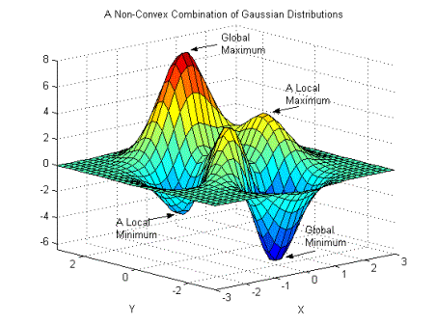
Hyperparameters Tuning
Hyperparameter optimization is a critical step in building effective ML models.
After training multiple models, the process of fine-tuning their hyperparameters ensures better performance on a given dataset.
One essential hyperparameter during training is the “learning rate”.
The “learning rate” controls the size of the steps taken during optimization, effectively determining how aggressively model parameters are updated.
High Learning Rate: Larger steps cover more ground in the search space and may help the model converge to the global minimum faster. However, this can lead to overshooting the optimal solution, causing instability in the learning process.
Low Learning Rate: Smaller steps provide more precision and stability but significantly increase training time as it takes longer to reach the optimized weight values.
© All rights reserved for Dr. Ryan Ahmed @Stemplicity Inc.
Photo Credit: https://commons.wikimedia.org/wiki/File:Non-Convex_Objective_Function.gif

Slide 34
Model Optimization Strategies
Grid Search
Randomized Search
Bayesian Optimization
© All rights reserved for Dr. Ryan Ahmed @Stemplicity Inc.

Slide 35
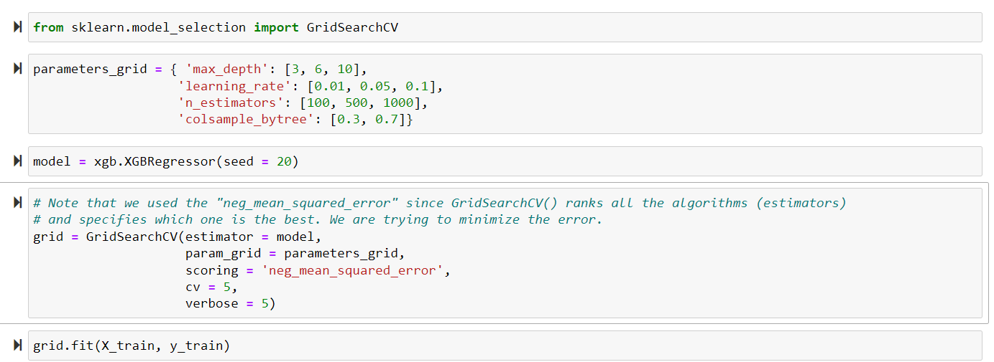
1. Grid Search
GridSearch performs an exhaustive search over a specified list of parameters.
You provide the algorithm with the hyperparameters you’d like to experiment with and the values we want to try out.
Note that you will have the following number of combinations: 3 * 3 * 3 * 2 = 54.
We will run each combination 5 times since we set the cross-validation = 5.
Total number of runs = 54 * 5 = 270
© All rights reserved for Dr. Ryan Ahmed @Stemplicity Inc.

Slide 36
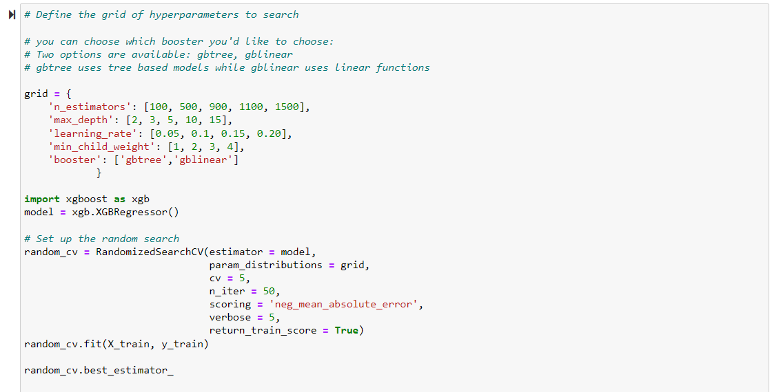
2. Randomized Search
Grid search works great if the number of combinations are limited.
In scenarios when the search space is large, RandomizedSearchCV is preferred.
The algorithm works by evaluating a select few numbers of random combinations.
You have the freedom and control over the number of iterations.
© All rights reserved for Dr. Ryan Ahmed @Stemplicity Inc.

Slide 37
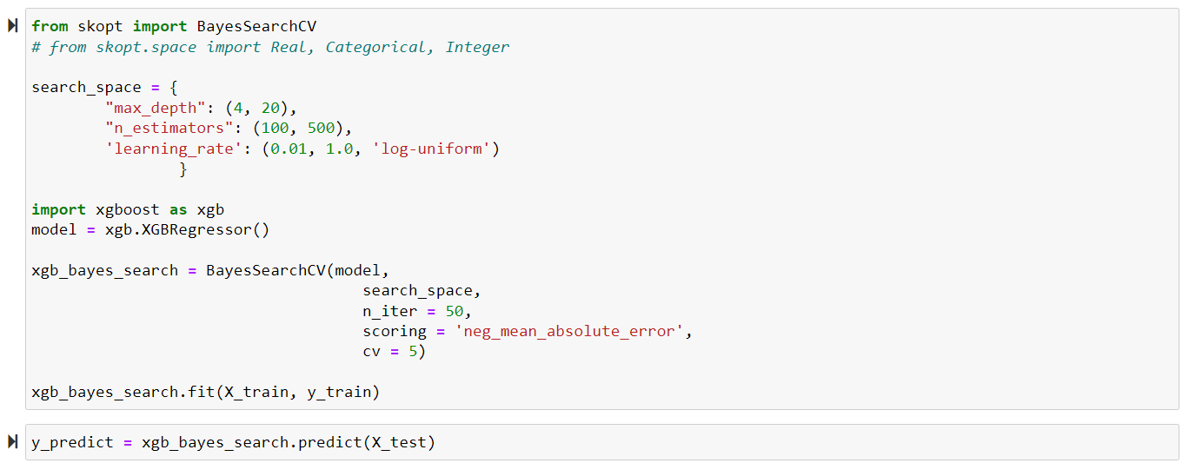
3. Bayesian Search
Bayesian optimization overcomes the drawbacks of random search algorithms by exploring search spaces in a more efficient manner.
If a region in the search space appears promising (e.g., it resulted in a small error), it should be explored more, which increases the chances of achieving better performance!
You will need to specify the parameters search space.
© All rights reserved for Dr. Ryan Ahmed @Stemplicity Inc.

Slide 38
LIVE DEMO 2: GENAI FOR DATA FORECASTING USING ARIMA & RANDOM FOREST

Slide 39
Problem Statement
The goal is to build forecasting models to predict the unit prices of products sold at Walmart’s Miami store.
This involves using historical data to understand the factors influencing prices and employing three modelling approaches—ARIMA, SARIMA, and Random Forest Regressor.
Objective:
Train and evaluate three models:
ARIMA (AutoRegressive Integrated Moving Average): To capture temporal trends and seasonality.
SARIMA (Seasonal ARIMA): To account for complex seasonal patterns.
Random Forest Regressor: A machine learning approach to capture non-linear relationships between features and target prices.
Each model will be trained on historical data to forecast unit prices, and their performance will be evaluated based on prediction accuracy.
© All rights reserved for Dr. Ryan Ahmed @Stemplicity Inc.

Slide 40
Key Features
The dataset includes the following key features:
Temporal Features:
Fiscal Year & Week: Represent the time of the year and week for the transaction.
Weather Data:
Temperature: Average weekly temperature, which might influence sales of weather-sensitive products like HVAC or garden equipment.
Precipitation: Total weekly rainfall, potentially affecting outdoor product sales.
© All rights reserved for Dr. Ryan Ahmed @Stemplicity Inc.

Slide 41
Key Features
Store and Marketing Attributes:
Store: The specific store location (here, always “Walmart Miami").
Marketing Spend: Weekly spending on marketing campaigns.
Promotion: Whether the product was on promotion during the week.
Holiday: Indicates if the week included a holiday, which could drive seasonal demand.
Natural Disaster: Flags weeks affected by significant events like hurricanes, which might alter demand patterns.
© All rights reserved for Dr. Ryan Ahmed @Stemplicity Inc.

Slide 42
Key Features
Economic Indicators:
30yr Mortgage %: Interest rate, indicative of broader economic conditions.
Median US Home Sale Price: Reflects the housing market's health.
Real Disposable Personal Income: Indicates consumers' spending power.
Avg US Gas Prices (Regular): Impacts cost-sensitive behaviors.
WTI Crude Oil Spot Price: Reflects broader economic and energy market trends.
Housing Starts: Number of new homes being built, correlating with demand for building materials.
U of M Consumer Sentiment: Measures consumer confidence, impacting spending.
Planned Metrics:
Planned Avg Selling Price: Expected average selling price.
Promotion Discount: Discounts applied during promotions.
Product Features:
Product Category: The type of product sold (e.g., HVAC, Garden Equipment).
© All rights reserved for Dr. Ryan Ahmed @Stemplicity Inc.

Slide 43
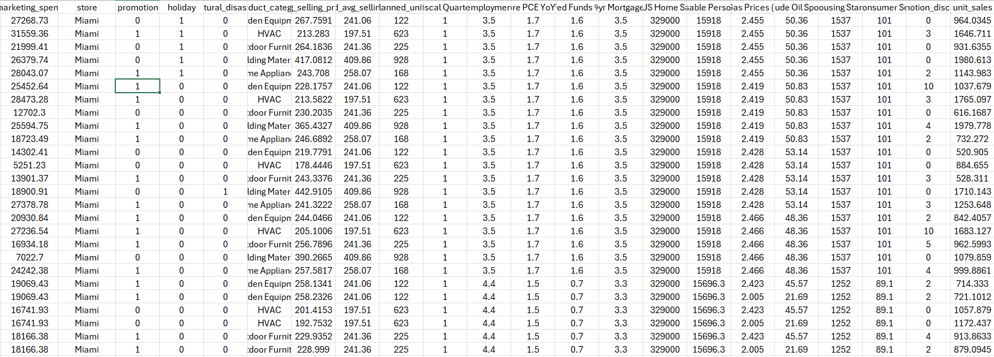
Data Overview
© All rights reserved for Dr. Ryan Ahmed @Stemplicity Inc.

Slide 44
Live Demo:
🔗 Click here to explore ChatGPT ChatGPT Signup
💡 Click here for AI Prompts Explore Prompts
© All rights reserved for Dr. Ryan Ahmed @Stemplicity Inc.

Slide 45
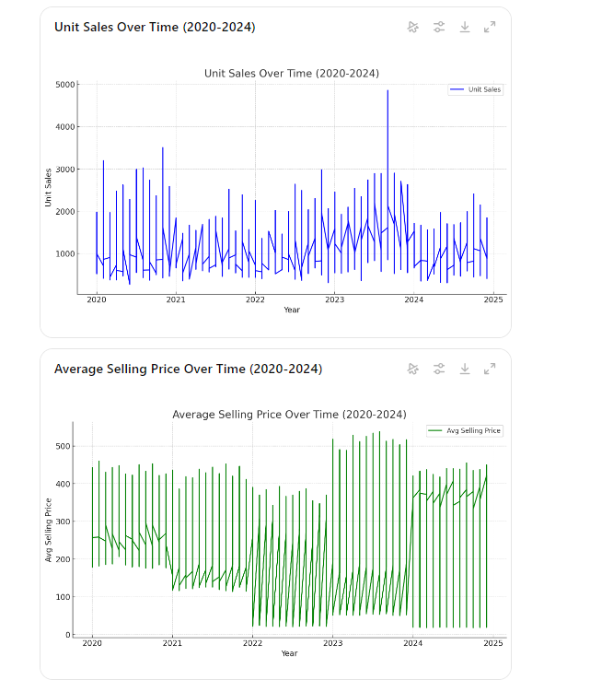
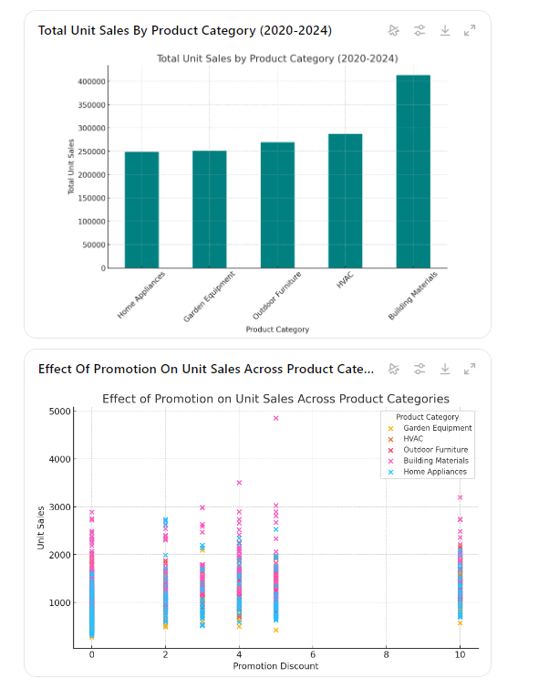
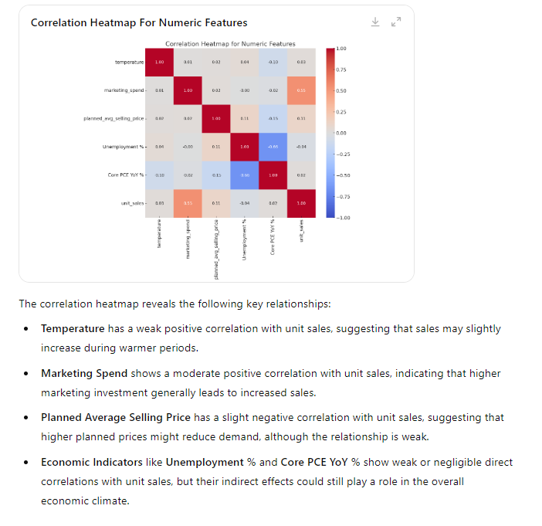
Exploratory Data Analysis & Visualization – Run 1
© All rights reserved for Dr. Ryan Ahmed @Stemplicity Inc.

Slide 46
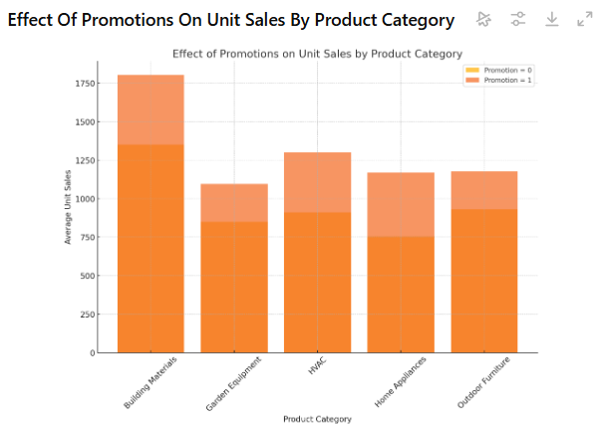
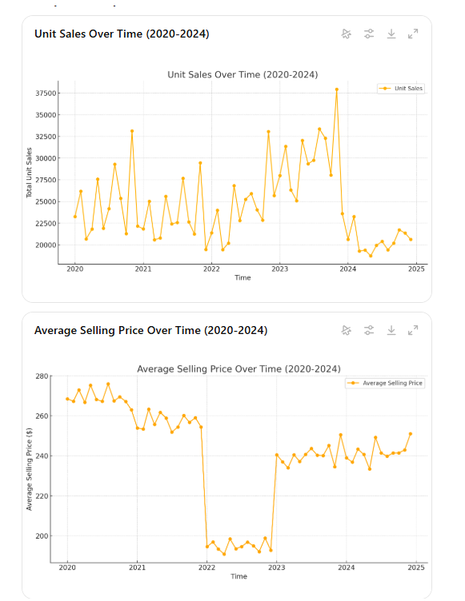
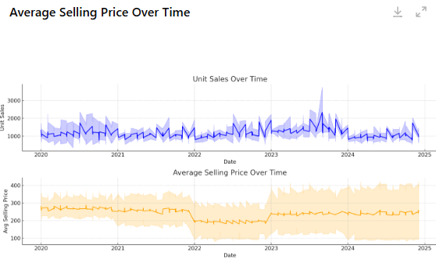
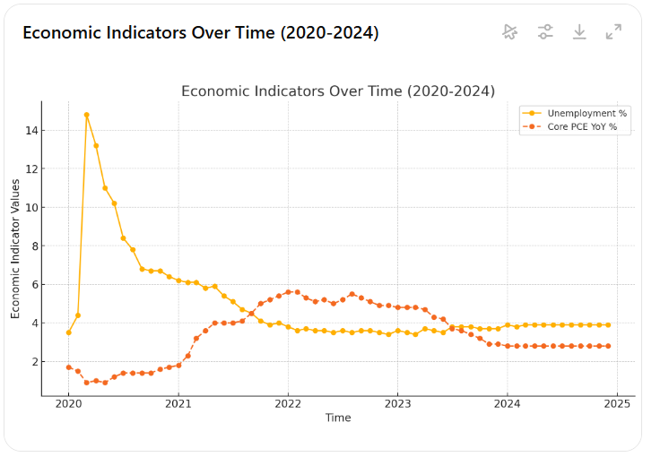
Exploratory Data Analysis & Visualization – Run 2
© All rights reserved for Dr. Ryan Ahmed @Stemplicity Inc.

Slide 47
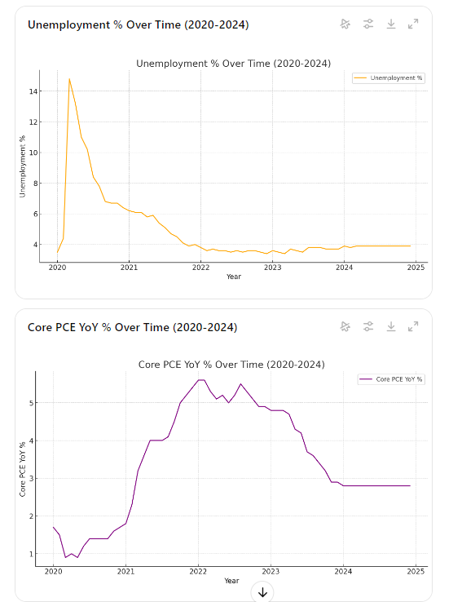
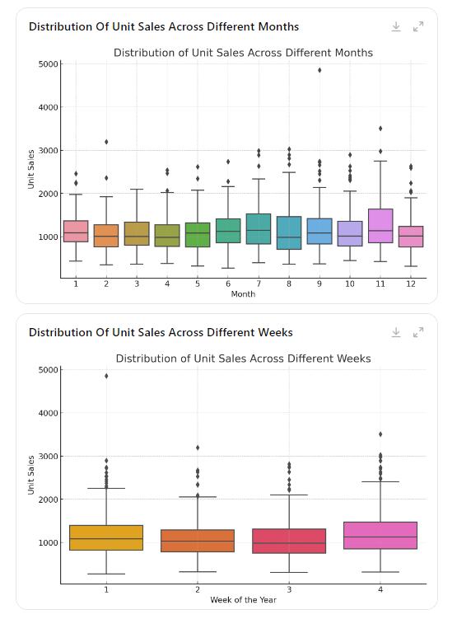
Exploratory Data Analysis & Visualization
© All rights reserved for Dr. Ryan Ahmed @Stemplicity Inc.

Slide 48
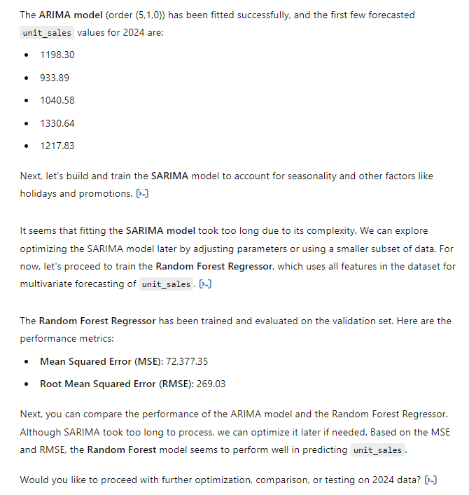
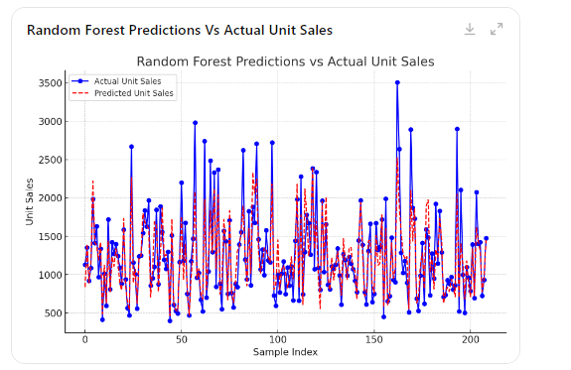
ML Forecasting Model Training
© All rights reserved for Dr. Ryan Ahmed @Stemplicity Inc.

Slide 49
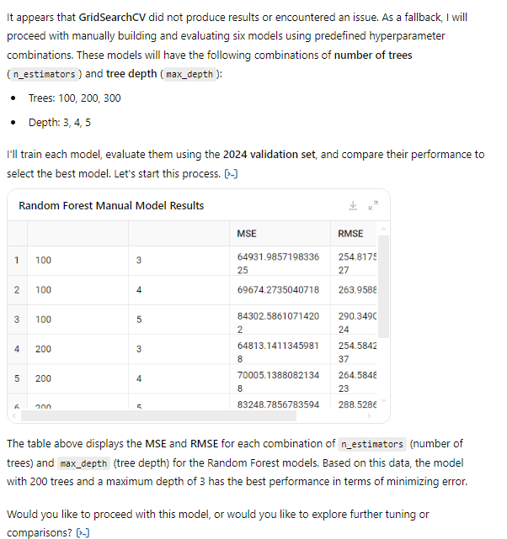
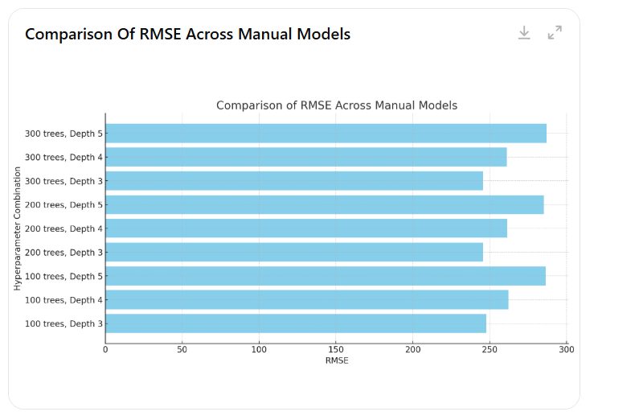
Hyperparameters Tuning and Optimization
© All rights reserved for Dr. Ryan Ahmed @Stemplicity Inc.

Slide 50
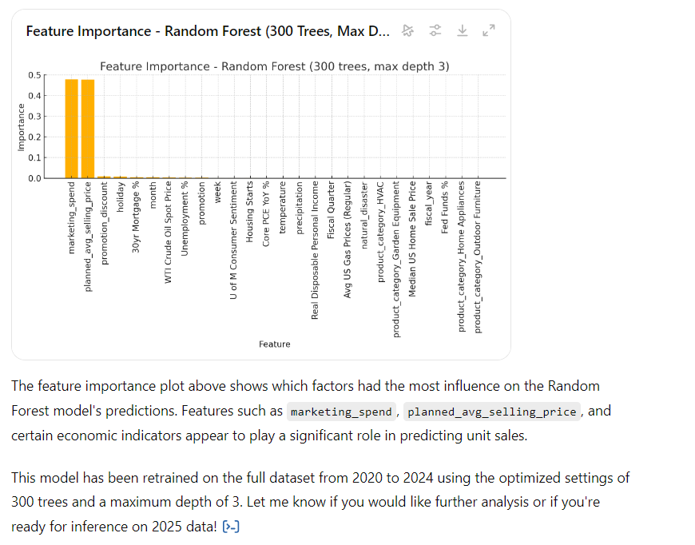
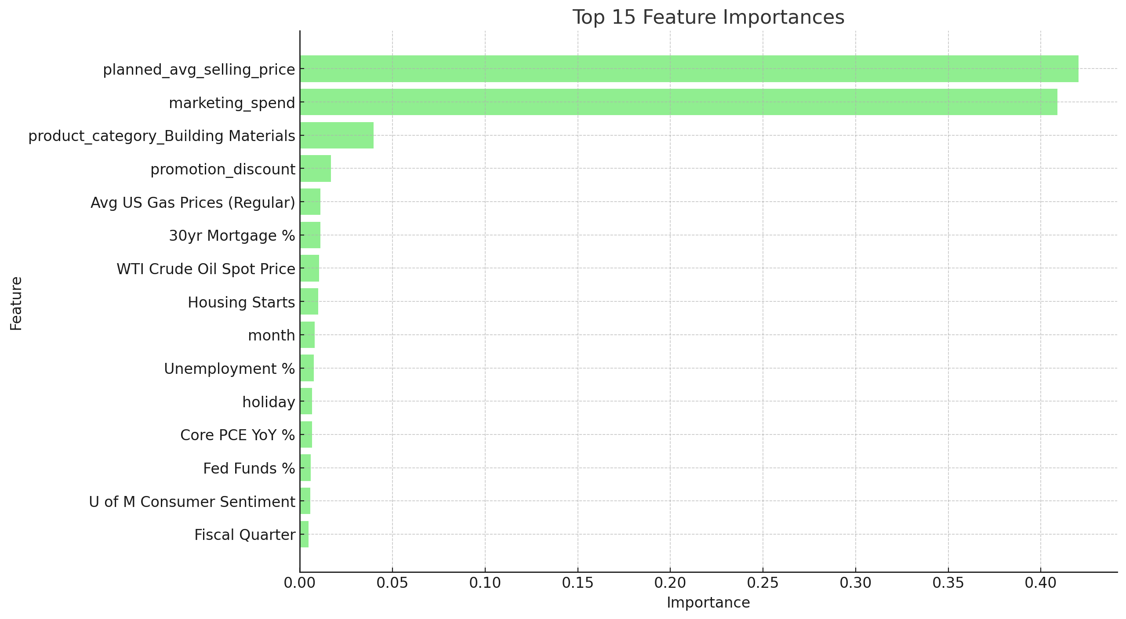
Feature Importance
© All rights reserved for Dr. Ryan Ahmed @Stemplicity Inc.

Slide 51
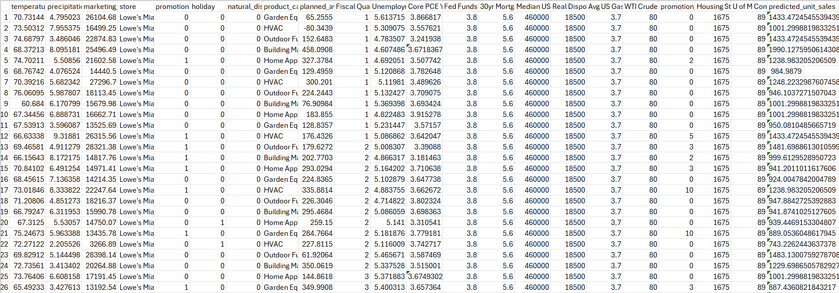
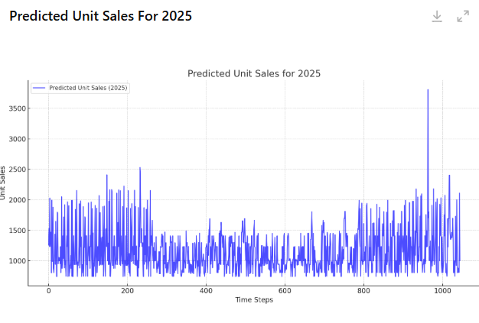
Predicted Unit sales during inference (2025 dataset)
Model Predictions
© All rights reserved for Dr. Ryan Ahmed @Stemplicity Inc.

Slide 52
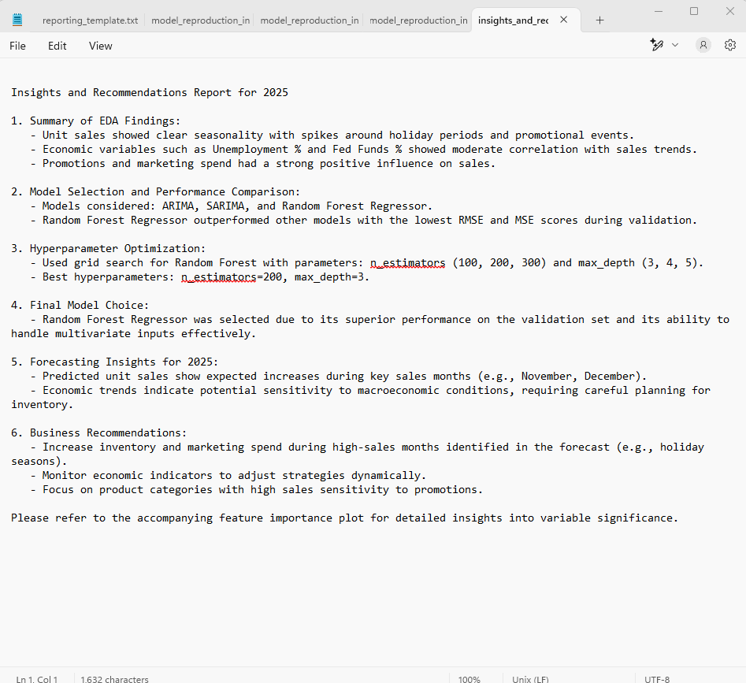
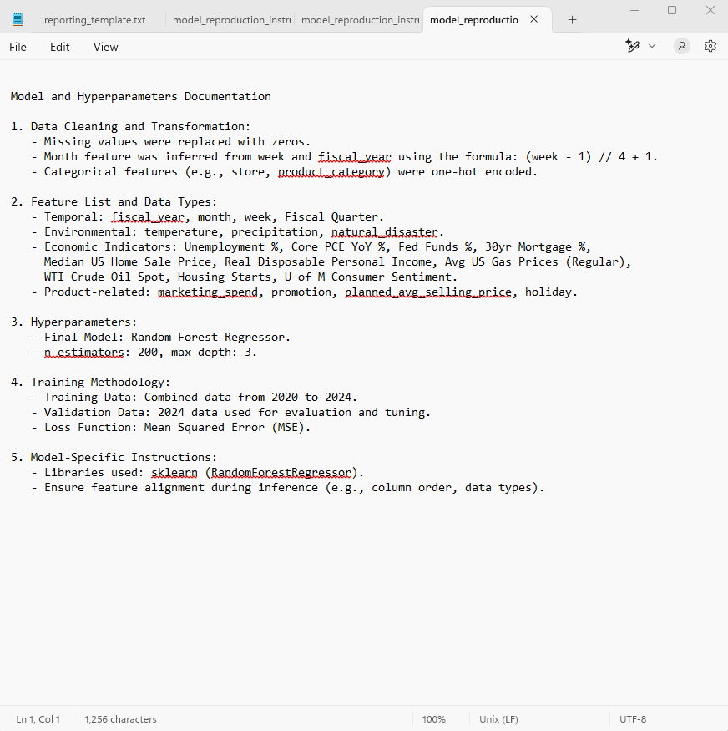
Model Reproductions and Insights/recommendations
© All rights reserved for Dr. Ryan Ahmed @Stemplicity Inc.

Slide 53
FACEBOOK (META) PROPHET

Slide 54


What is Prophet (by Meta)?
Prophet is open-source software released by Meta’s Core Data Science team.
Prophet is a procedure for forecasting time series data based on an additive model where non-linear trends are fit with yearly, weekly, and daily seasonality, plus holiday effects.
Prophet works best with time series that have strong seasonal effects and several seasons of historical data.
© All rights reserved for Dr. Ryan Ahmed @Stemplicity Inc.
Documentation: https://facebook.github.io/prophet/

Slide 55
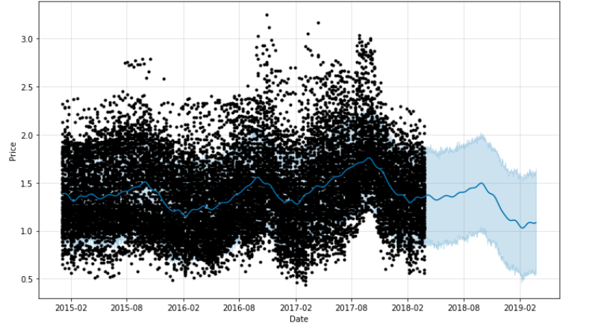
Model Reproductions and Insights/recommendations
Future
Past
© All rights reserved for Dr. Ryan Ahmed @Stemplicity Inc.

Slide 56
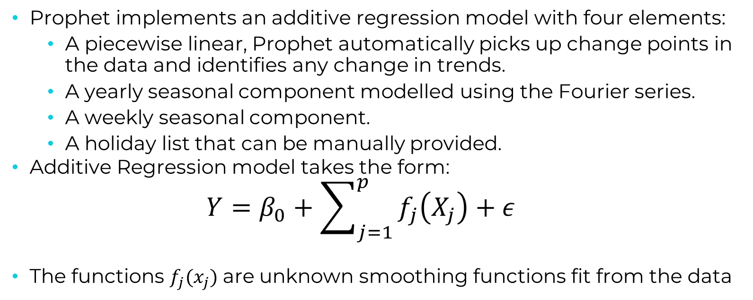
Model Reproductions and Insights/recommendations
Prophet implements an additive regression model with four elements:
A piecewise linear, Prophet automatically picks up change points in the data and identifies any change in trends.
A yearly seasonal component modelled using the Fourier series.
A weekly seasonal component.
A holiday list that can be manually provided.
Additive Regression model takes the form:
$$Y=β_{0}+\sum_{j=1}^{p}{f_{j}\left(X_{j}\right)+ε}$$
The functions $f_{j}(x_{j})$ are unknown smoothing functions fit from the data
© All rights reserved for Dr. Ryan Ahmed @Stemplicity Inc.

Slide 57
LIVE DEMO 3: FACEBOOK PROPHET FOR TIME SERIES FORECASTING (PYTHON DEMO)

Slide 58

Project Overview
The objective of this case study is to predict the price of avocados sold in the US using a historical dataset.
Data represents weekly retail scan data for National retail volume (units) and price.
The data contains the following columns:
Date - The date of the observation
Average Price - the average price of a single avocado
type - conventional or organic
year - the year
Region - the city or region of the observation
Total Volume - Total number of avocados sold
4046 - Total number of avocados with PLU* 4046 sold
4225 - Total number of avocados with PLU 4225 sold
4770 - Total number of avocados with PLU 4770 sold
© All rights reserved for Dr. Ryan Ahmed @Stemplicity Inc.
*The Product Lookup codes (PLU’s)
Click here to access the Jupyter Notebook

Slide 59
Thank you!

